Slide 1

Mr. Amol Jadhav Assistant Professor Department of Mathematics Vidya Pratishthan’s Kamalnayan Bajaj Institute of Engineering and Technology, Baramati
Subject: Engineering Mathematics-III Topic: Inverse Z-Transform
Subtopic: Inversion Integral Method Lecture No.- 07

Slide 2
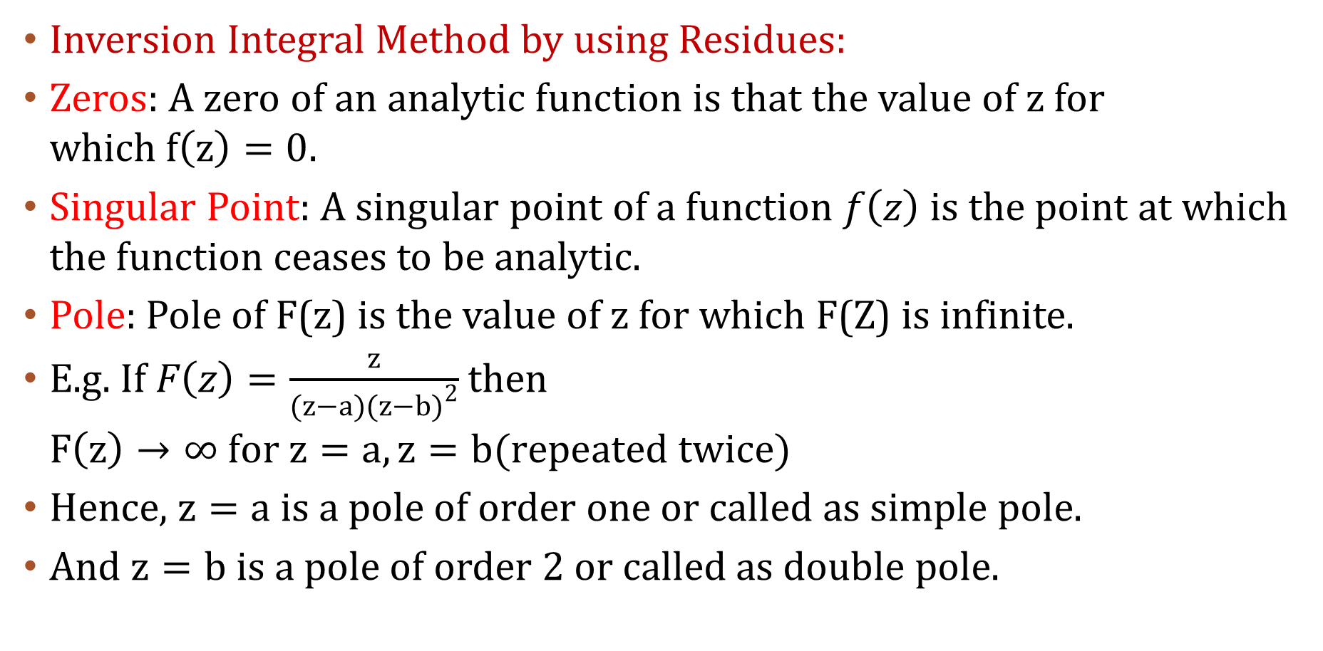
INVERSE Z-Transform
Inversion Integral Method by using Residues:
Zeros: A zero of an analytic function is that the value of z for which$f\left(z\right)=0.$
Singular Point: A singular point of a function $f\left(z\right)$ is the point at which the function ceases to be analytic.
Pole: Pole of F(z) is the value of z for which F(Z) is infinite.
E.g. If $F\left(z\right)=\frac{z}{(z−a){(z−b)}^{2}}$ then $F\left(z\right)→∞ for z=a, z=b(repeated twice)$
Hence, $z=a$ is a pole of order one or called as simple pole.
And $z=b$ is a pole of order 2 or called as double pole.

Slide 3
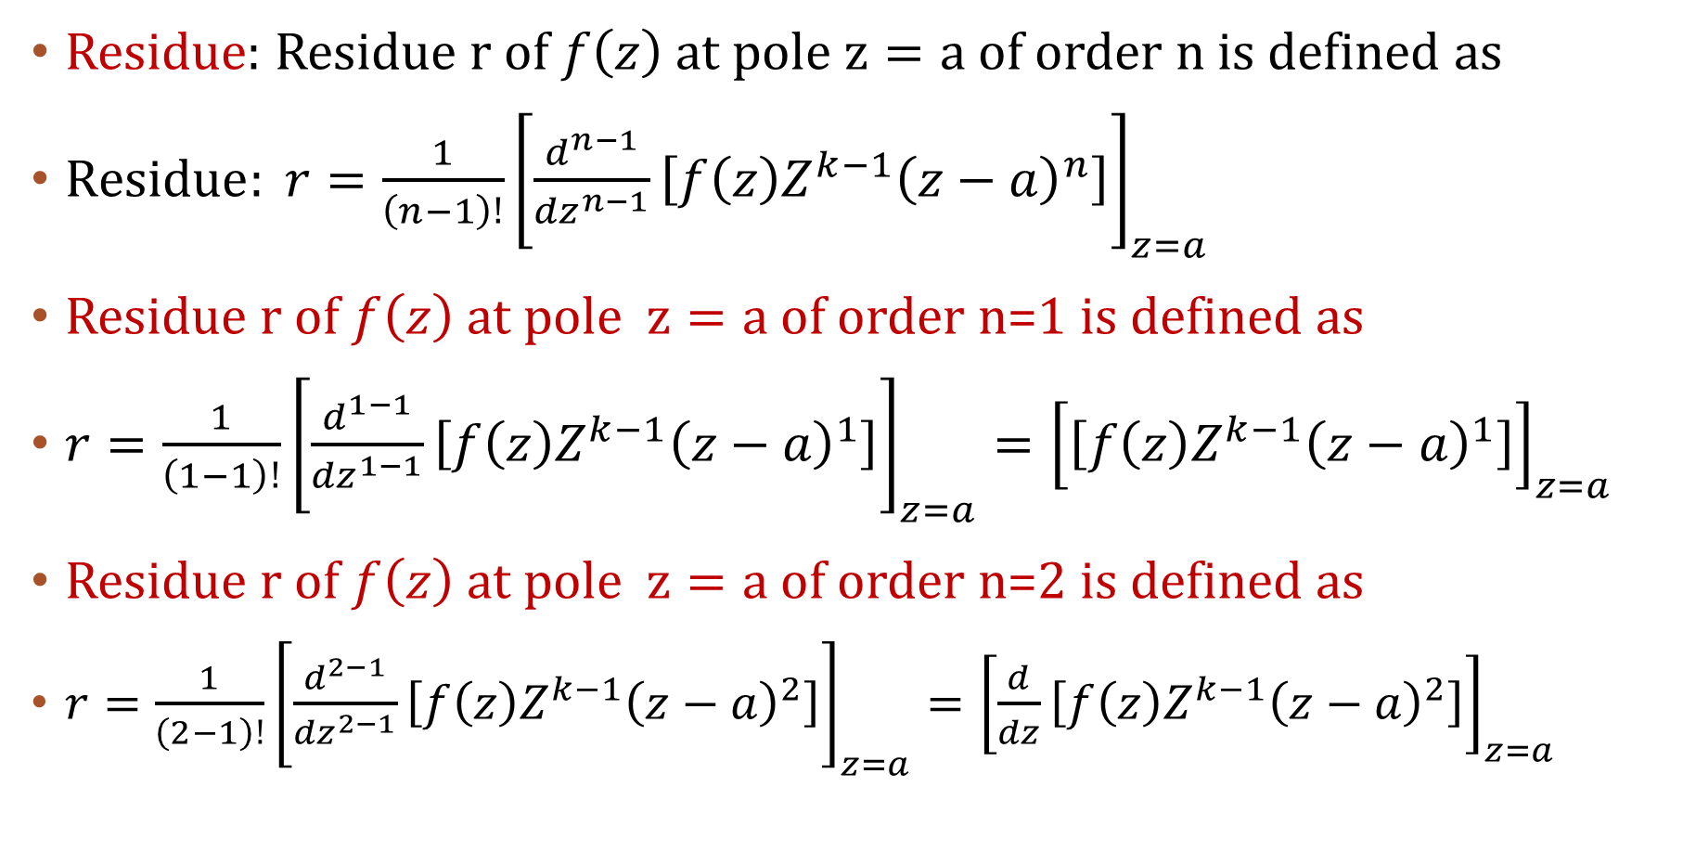
Residue: Residue r of $f\left(z\right)$ at pole $z=a$ of order n is defined as
$Residue: r=\frac{1}{\left(n−1\right)!}{\left[\frac{d^{n−1}}{{dz}^{n−1}}\left[{f\left(z\right)Z^{k−1}\left(z−a\right)}^{n}\right]\right]}_{z=a}$
Residue r of $f\left(z\right)$ at pole $z=a$ of order n=1 is defined as
$r=\frac{1}{\left(1−1\right)!}{\left[\frac{d^{1−1}}{{dz}^{1−1}}\left[{f\left(z\right)Z^{k−1}\left(z−a\right)}^{1}\right]\right]}_{z=a}={\left[\left[{f\left(z\right)Z^{k−1}\left(z−a\right)}^{1}\right]\right]}_{z=a}$
Residue r of $f\left(z\right)$ at pole $z=a$ of order n=2 is defined as
$r=\frac{1}{\left(2−1\right)!}{\left[\frac{d^{2−1}}{{dz}^{2−1}}\left[{f\left(z\right)Z^{k−1}\left(z−a\right)}^{2}\right]\right]}_{z=a}{=\left[\frac{d}{dz}\left[{f\left(z\right)Z^{k−1}\left(z−a\right)}^{2}\right]\right]}_{z=a}$

Slide 4
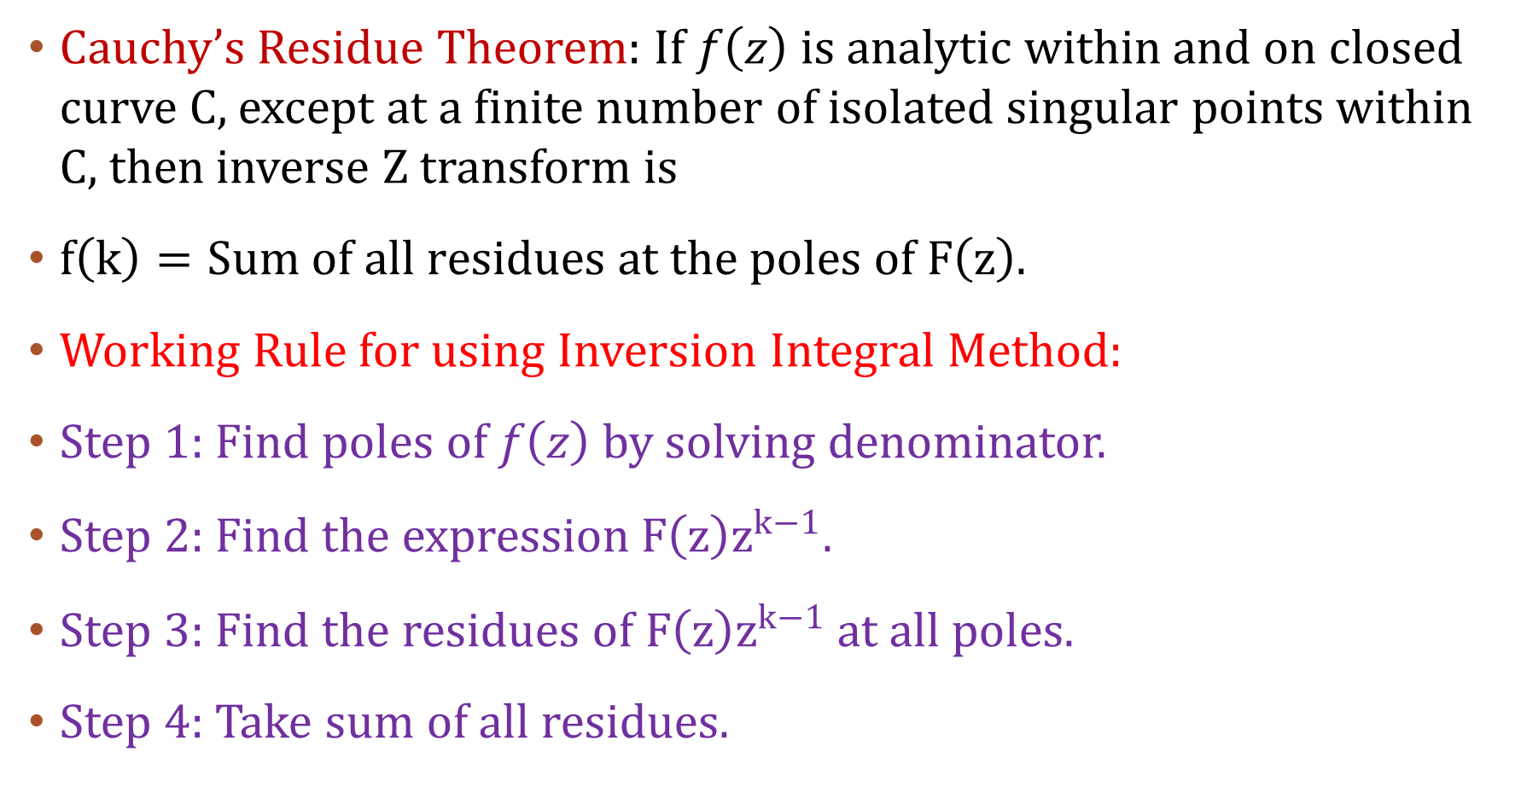
Cauchy’s Residue Theorem: If $f\left(z\right)$ is analytic within and on closed curve C, except at a finite number of isolated singular points within C, then inverse Z transform is
$f\left(k\right)=Sum of all residues at the poles of F\left(z\right).$
Working Rule for using Inversion Integral Method:
Step 1: Find poles of $f\left(z\right)$ by solving denominator.
Step 2: Find the expression$F\left(z\right)z^{k−1}$.
Step 3: Find the residues of $F\left(z\right)z^{k−1}$ at all poles.
Step 4: Take sum of all residues.

Slide 5
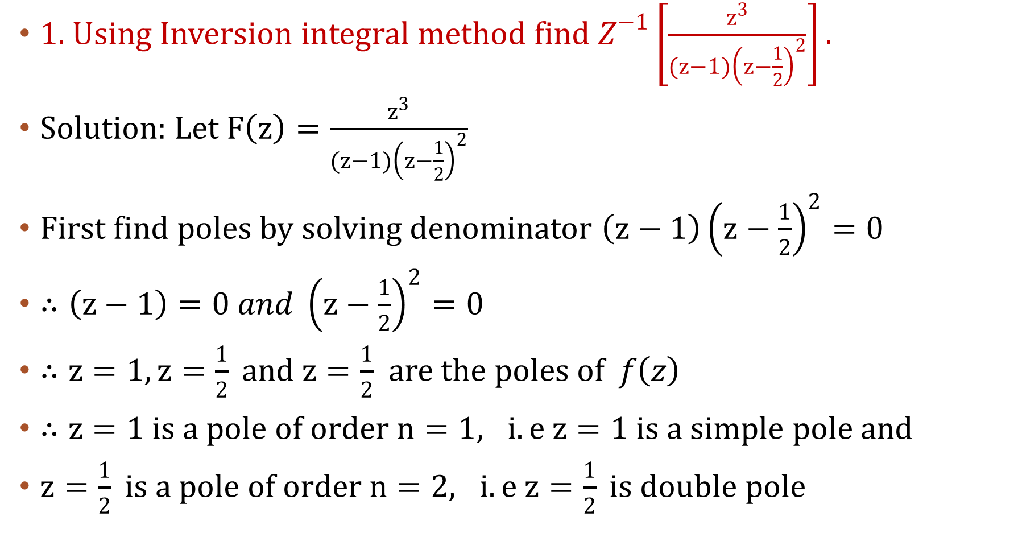
1. Using Inversion integral method find $Z^{−1}\left[\frac{z^{3}}{(z−1){\left(z−\frac{1}{2}\right)}^{2}}\right].$
Solution: Let $F\left(z\right)=\frac{z^{3}}{(z−1){\left(z−\frac{1}{2}\right)}^{2}}$
First find poles by solving denominator $\left(z−1\right){\left(z−\frac{1}{2}\right)}^{2}=0$
$∴\left(z−1\right)=0 and {\left(z−\frac{1}{2}\right)}^{2}=0$
$∴z=1, z=\frac{1}{2} and z=\frac{1}{2}$ are the poles of $f\left(z\right)$
$∴z=1 is a pole of order n=1, i.e z=1 is a simple pole$ and
$z=\frac{1}{2} is a pole of order n=2, i.e z=\frac{1}{2} is double pole$

Slide 6
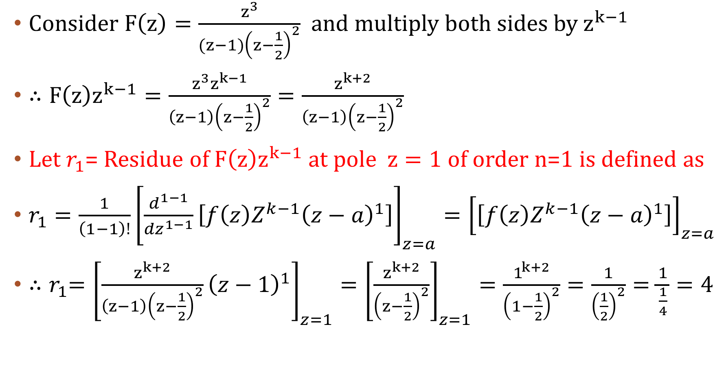
Consider $F\left(z\right)=\frac{z^{3}}{(z−1){\left(z−\frac{1}{2}\right)}^{2}}$ and multiply both sides by $z^{k−1}$
$∴F\left(z\right)z^{k−1}=\frac{z^{3}z^{k−1}}{\left(z−1\right){\left(z−\frac{1}{2}\right)}^{2}}=\frac{z^{k+2}}{\left(z−1\right){\left(z−\frac{1}{2}\right)}^{2}}$
Let $r_{1}$= Residue of $F\left(z\right)z^{k−1}$ at pole $z=1$ of order n=1 is defined as
$r_{1}=\frac{1}{\left(1−1\right)!}{\left[\frac{d^{1−1}}{{dz}^{1−1}}\left[{f\left(z\right)Z^{k−1}\left(z−a\right)}^{1}\right]\right]}_{z=a}={\left[\left[{f\left(z\right)Z^{k−1}\left(z−a\right)}^{1}\right]\right]}_{z=a}$
${∴r}_{1}={\left[{\frac{z^{k+2}}{\left(z−1\right){\left(z−\frac{1}{2}\right)}^{2}}\left(z−1\right)}^{1}\right]}_{z=1}={\left[\frac{z^{k+2}}{{\left(z−\frac{1}{2}\right)}^{2}}\right]}_{z=1}=\frac{1^{k+2}}{{\left(1−\frac{1}{2}\right)}^{2}}=\frac{1}{{\left(\frac{1}{2}\right)}^{2}}=\frac{1}{\frac{1}{4}}=4$

Slide 7
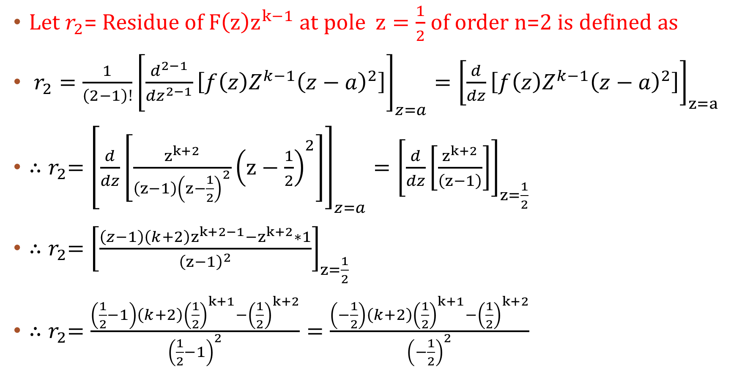
Let $r_{2}$= Residue of $F\left(z\right)z^{k−1}$ at pole $z=\frac{1}{2}$ of order n=2 is defined as
$r_{2}=\frac{1}{\left(2−1\right)!}{\left[\frac{d^{2−1}}{{dz}^{2−1}}\left[{f\left(z\right)Z^{k−1}\left(z−a\right)}^{2}\right]\right]}_{z=a}={\left[\frac{d}{dz}\left[{f\left(z\right)Z^{k−1}\left(z−a\right)}^{2}\right]\right]}_{z=a}$
${∴r}_{2}={\left[\frac{d}{dz}\left[{\frac{z^{k+2}}{\left(z−1\right){\left(z−\frac{1}{2}\right)}^{2}}\left(z−\frac{1}{2}\right)}^{2}\right]\right]}_{z=a}={\left[\frac{d}{dz}\left[\frac{z^{k+2}}{\left(z−1\right)}\right]\right]}_{z=\frac{1}{2}}$
${∴r}_{2}={\left[\frac{\left(z−1\right)\left(k+2\right)z^{k+2−1}−z^{k+2}∗1}{{\left(z−1\right)}^{2}}\right]}_{z=\frac{1}{2}}$
${∴r}_{2}=\frac{\left(\frac{1}{2}−1\right)\left(k+2\right){\left(\frac{1}{2}\right)}^{k+1}−{\left(\frac{1}{2}\right)}^{k+2}}{{\left(\frac{1}{2}−1\right)}^{2}}=\frac{\left(−\frac{1}{2}\right)\left(k+2\right){\left(\frac{1}{2}\right)}^{k+1}−{\left(\frac{1}{2}\right)}^{k+2}}{{\left(−\frac{1}{2}\right)}^{2}}$

Slide 8
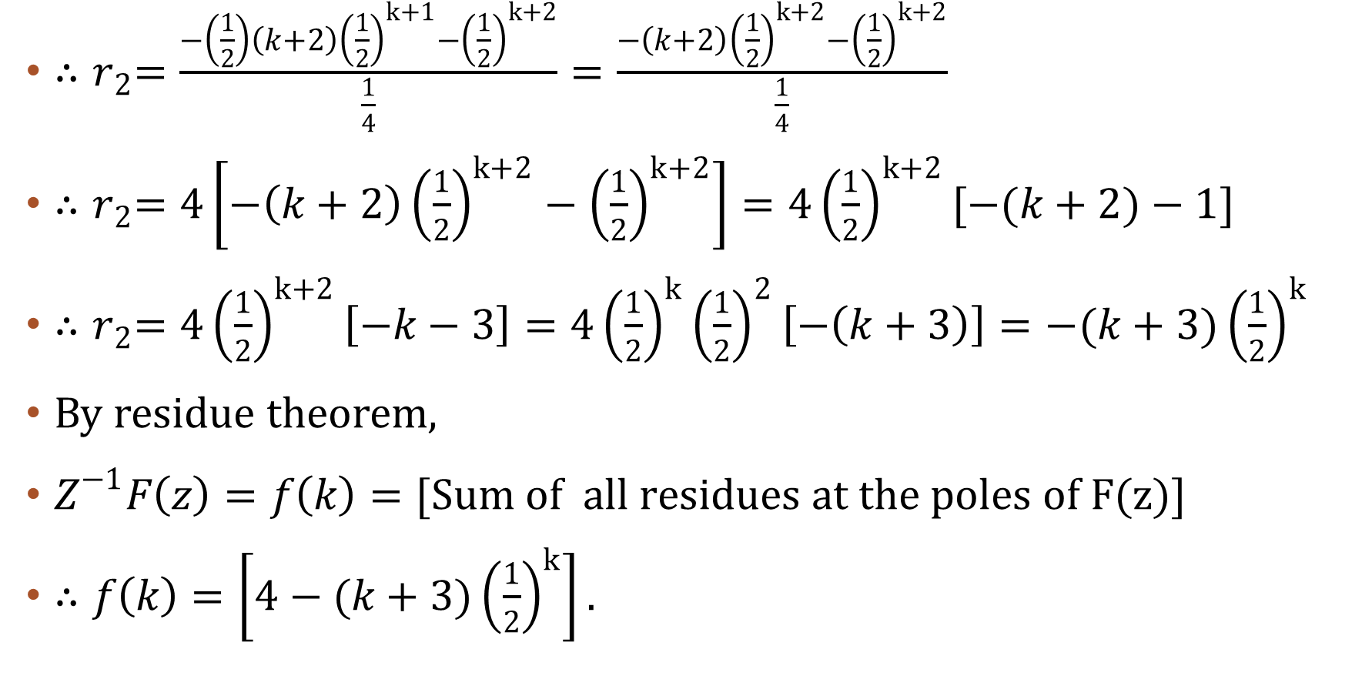
${∴r}_{2}=\frac{−\left(\frac{1}{2}\right)\left(k+2\right){\left(\frac{1}{2}\right)}^{k+1}−{\left(\frac{1}{2}\right)}^{k+2}}{\frac{1}{4}}=\frac{−\left(k+2\right){\left(\frac{1}{2}\right)}^{k+2}−{\left(\frac{1}{2}\right)}^{k+2}}{\frac{1}{4}}$
${∴r}_{2}=4\left[−\left(k+2\right){\left(\frac{1}{2}\right)}^{k+2}−{\left(\frac{1}{2}\right)}^{k+2}\right]=4{\left(\frac{1}{2}\right)}^{k+2}[−(k+2)−1]$
${∴r}_{2}=4{\left(\frac{1}{2}\right)}^{k+2}\left[−k−3\right]=4{\left(\frac{1}{2}\right)}^{k}{\left(\frac{1}{2}\right)}^{2}\left[−\left(k+3\right)\right]=−(k+3){\left(\frac{1}{2}\right)}^{k}$
By residue theorem,
$Z^{−1}F\left(z\right)=f\left(k\right)=[Sum of all residues at the poles of F(z)]$
$∴f\left(k\right)=\left[4−(k+3){\left(\frac{1}{2}\right)}^{k}\right].$

Slide 9
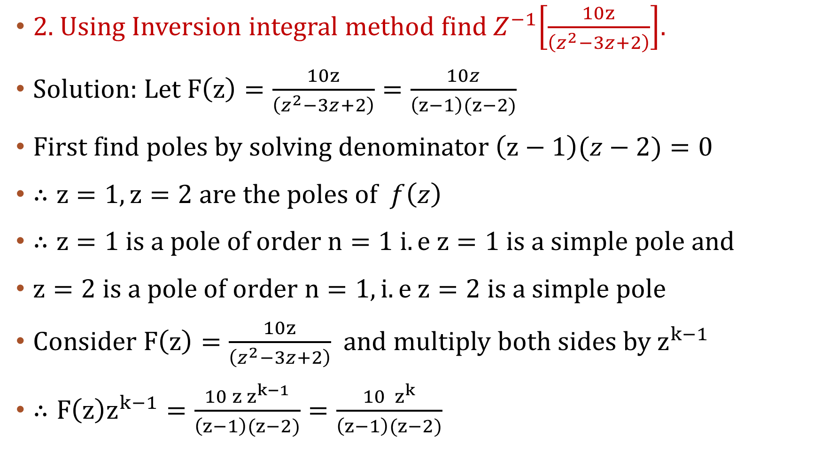
2. Using Inversion integral method find${ Z}^{−1}\left[\frac{10z}{\left(z^{2}−3z+2\right)}\right]$.
Solution: Let $F\left(z\right)=\frac{10z}{\left(z^{2}−3z+2\right)}=\frac{10z}{\left(z−1\right)(z−2)}$
First find poles by solving denominator$\left(z−1\right)(z−2)=0$
$∴z=1, z=2$ are the poles of $f\left(z\right)$
$∴z=1 is a pole of order n=1 i.e z=1 is a simple pole$ and
$z=2 is a pole of order n=1, i.e z=2 is a simple pole$
Consider $F\left(z\right)=\frac{10z}{\left(z^{2}−3z+2\right)}$ and multiply both sides by $z^{k−1}$
$∴F\left(z\right)z^{k−1}=\frac{{10 z z}^{k−1}}{\left(z−1\right)(z−2)}=\frac{{10 z}^{k}}{\left(z−1\right)(z−2)}$

Slide 10
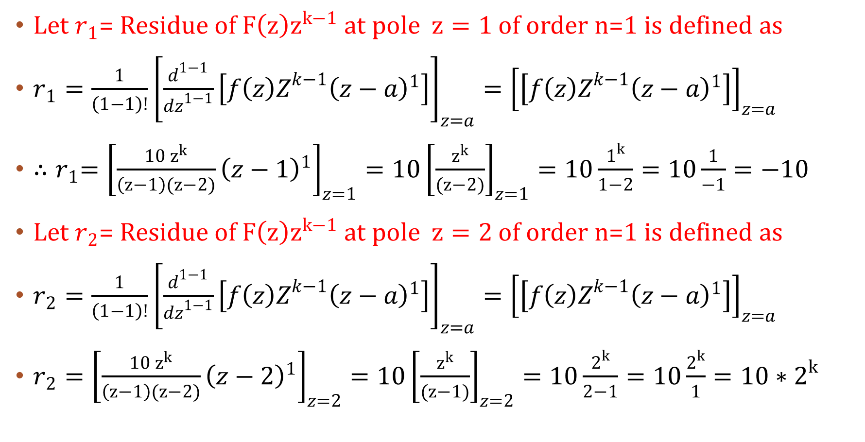
Let $r_{1}$= Residue of $F\left(z\right)z^{k−1}$ at pole $z=1$ of order n=1 is defined as
$r_{1}=\frac{1}{\left(1−1\right)!}{\left[\frac{d^{1−1}}{{dz}^{1−1}}\left[{f\left(z\right)Z^{k−1}\left(z−a\right)}^{1}\right]\right]}_{z=a}={\left[\left[{f\left(z\right)Z^{k−1}\left(z−a\right)}^{1}\right]\right]}_{z=a}$
${∴r}_{1}={\left[{\frac{10 z^{k}}{\left(z−1\right)(z−2)}\left(z−1\right)}^{1}\right]}_{z=1}={10\left[\frac{z^{k}}{(z−2)}\right]}_{z=1}=10\frac{1^{k}}{1−2}=10\frac{1}{−1}=−10$
Let $r_{2}$= Residue of $F\left(z\right)z^{k−1}$ at pole $z=2$ of order n=1 is defined as
$r_{2}=\frac{1}{\left(1−1\right)!}{\left[\frac{d^{1−1}}{{dz}^{1−1}}\left[{f\left(z\right)Z^{k−1}\left(z−a\right)}^{1}\right]\right]}_{z=a}={\left[\left[{f\left(z\right)Z^{k−1}\left(z−a\right)}^{1}\right]\right]}_{z=a}$
$r_{2}={\left[{\frac{10 z^{k}}{\left(z−1\right)(z−2)}\left(z−2\right)}^{1}\right]}_{z=2}=10{\left[\frac{z^{k}}{(z−1)}\right]}_{z=2}=10\frac{2^{k}}{2−1}=10\frac{2^{k}}{1}=10∗2^{k}$

Slide 11
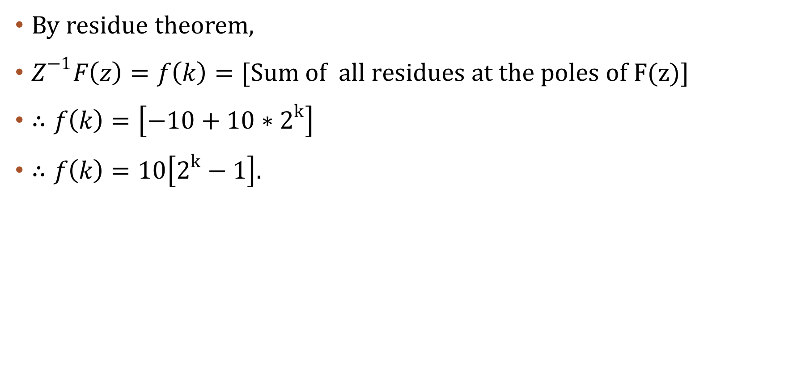
By residue theorem,
$Z^{−1}F\left(z\right)=f\left(k\right)=[Sum of all residues at the poles of F(z)]$
$∴f\left(k\right)=\left[−10+10∗2^{k}\right]$
$∴f\left(k\right)=10\left[2^{k}−1\right].$

Slide 12
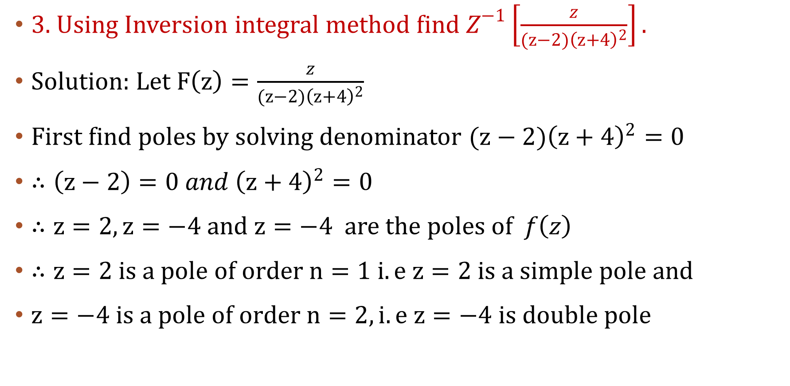
3. Using Inversion integral method find $Z^{−1}\left[\frac{z}{(z−2){\left(z+4\right)}^{2}}\right].$
Solution: Let $F\left(z\right)=\frac{z}{(z−2){\left(z+4\right)}^{2}}$
First find poles by solving denominator $(z−2){\left(z+4\right)}^{2}=0$
$∴\left(z−2\right)=0 and {\left(z+4\right)}^{2}=0$
$∴z=2, z=−4 and z=−4$ are the poles of $f\left(z\right)$
$∴z=2 is a pole of order n=1 i.e z=2 is a simple pole$ and
$z=−4 is a pole of order n=2, i.e z=−4 is double pole$

Slide 13
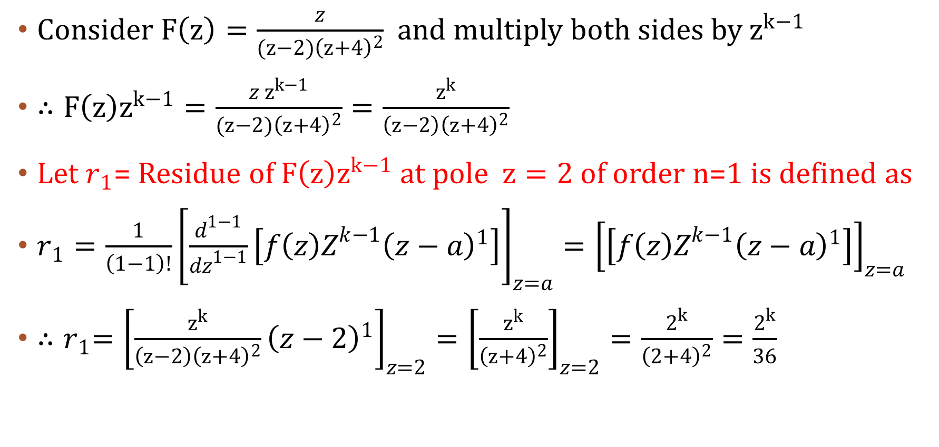
Consider $F\left(z\right)=\frac{z}{(z−2){\left(z+4\right)}^{2}}$ and multiply both sides by $z^{k−1}$
$∴F\left(z\right)z^{k−1}=\frac{z z^{k−1}}{(z−2){\left(z+4\right)}^{2}}=\frac{z^{k}}{\left(z−2\right){\left(z+4\right)}^{2}}$
Let $r_{1}$= Residue of $F\left(z\right)z^{k−1}$ at pole $z=2$ of order n=1 is defined as
$r_{1}=\frac{1}{\left(1−1\right)!}{\left[\frac{d^{1−1}}{{dz}^{1−1}}\left[{f\left(z\right)Z^{k−1}\left(z−a\right)}^{1}\right]\right]}_{z=a}={\left[\left[{f\left(z\right)Z^{k−1}\left(z−a\right)}^{1}\right]\right]}_{z=a}$
${∴r}_{1}={\left[{\frac{z^{k}}{\left(z−2\right){\left(z+4\right)}^{2}}\left(z−2\right)}^{1}\right]}_{z=2}={\left[\frac{z^{k}}{{\left(z+4\right)}^{2}}\right]}_{z=2}=\frac{2^{k}}{{\left(2+4\right)}^{2}}=\frac{2^{k}}{36}$

Slide 14
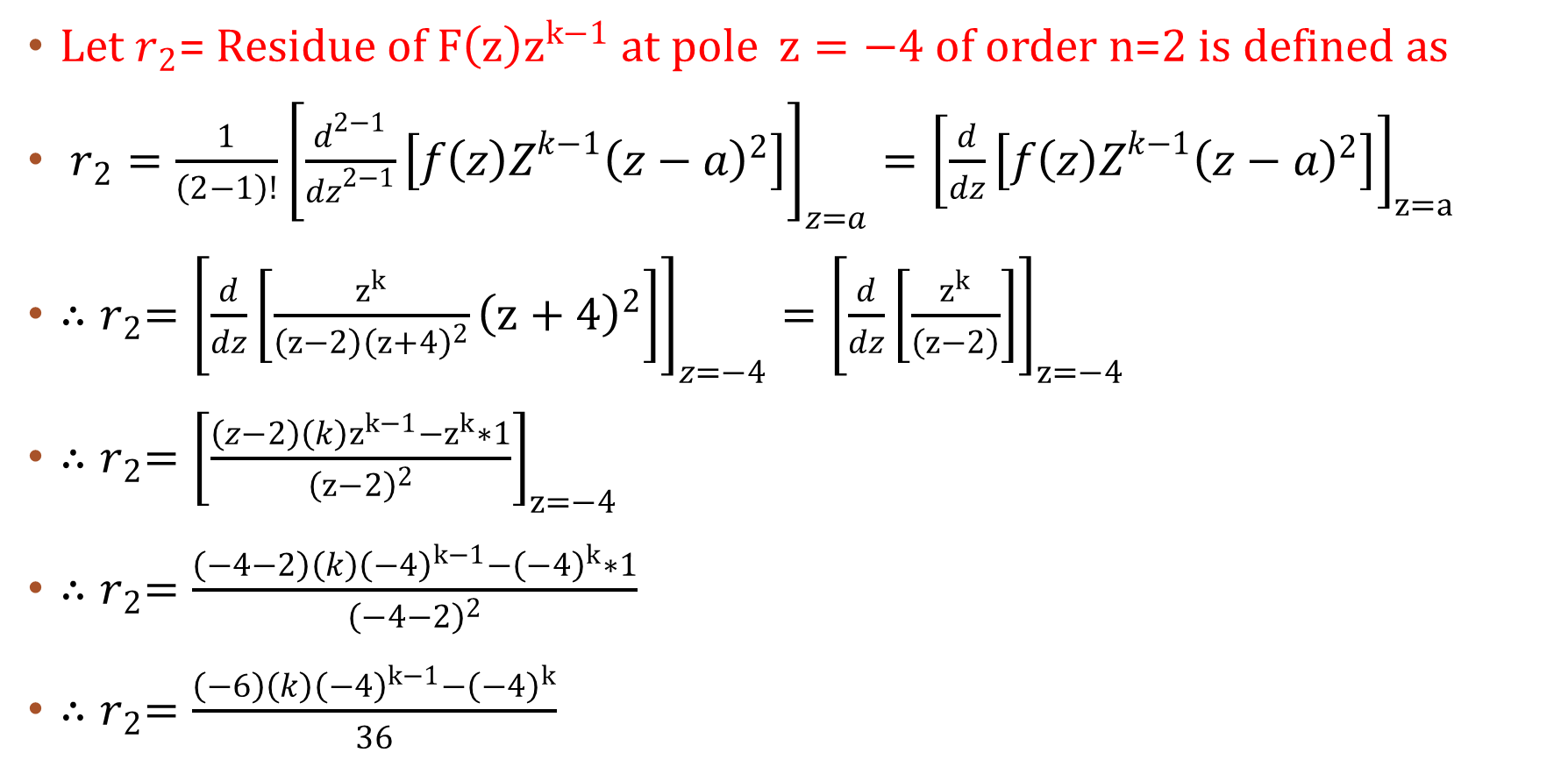
Let $r_{2}$= Residue of $F\left(z\right)z^{k−1}$ at pole $z=−4$ of order n=2 is defined as
$r_{2}=\frac{1}{\left(2−1\right)!}{\left[\frac{d^{2−1}}{{dz}^{2−1}}\left[{f\left(z\right)Z^{k−1}\left(z−a\right)}^{2}\right]\right]}_{z=a}={\left[\frac{d}{dz}\left[{f\left(z\right)Z^{k−1}\left(z−a\right)}^{2}\right]\right]}_{z=a}$
${∴r}_{2}={\left[\frac{d}{dz}\left[{\frac{z^{k}}{\left(z−2\right){\left(z+4\right)}^{2}}\left(z+4\right)}^{2}\right]\right]}_{z=−4}={\left[\frac{d}{dz}\left[\frac{z^{k}}{\left(z−2\right)}\right]\right]}_{z=−4}$
${∴r}_{2}={\left[\frac{\left(z−2\right)\left(k\right)z^{k−1}−z^{k}∗1}{{\left(z−2\right)}^{2}}\right]}_{z=−4}$
${∴r}_{2}=\frac{\left(−4−2\right)\left(k\right){\left(−4\right)}^{k−1}−{\left(−4\right)}^{k}∗1}{{\left(−4−2\right)}^{2}}$
${∴r}_{2}=\frac{\left(−6\right)\left(k\right){\left(−4\right)}^{k−1}−{\left(−4\right)}^{k}}{36}$

Slide 15
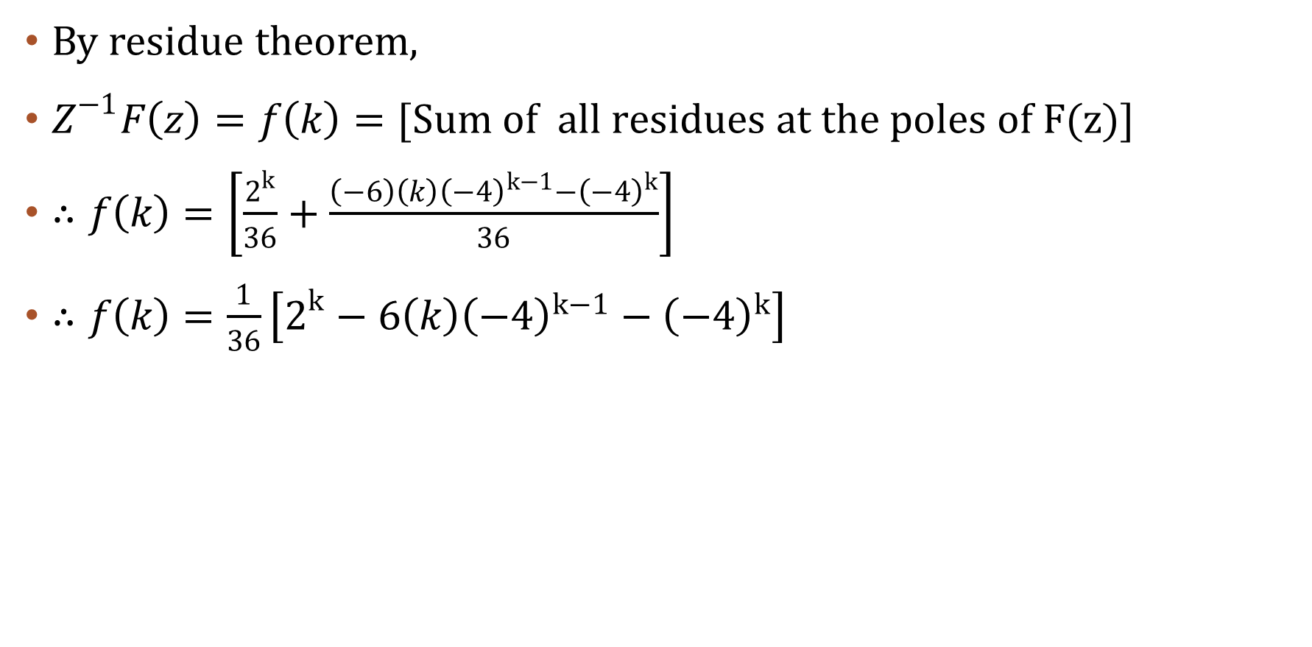
By residue theorem,
$Z^{−1}F\left(z\right)=f\left(k\right)=[Sum of all residues at the poles of F(z)]$
$∴f\left(k\right)=\left[\frac{2^{k}}{36}+\frac{\left(−6\right)\left(k\right){\left(−4\right)}^{k−1}−{\left(−4\right)}^{k}}{36}\right]$
$∴f\left(k\right)=\frac{1}{36}\left[2^{k}−6\left(k\right){\left(−4\right)}^{k−1}−{\left(−4\right)}^{k}\right]$

Slide 16
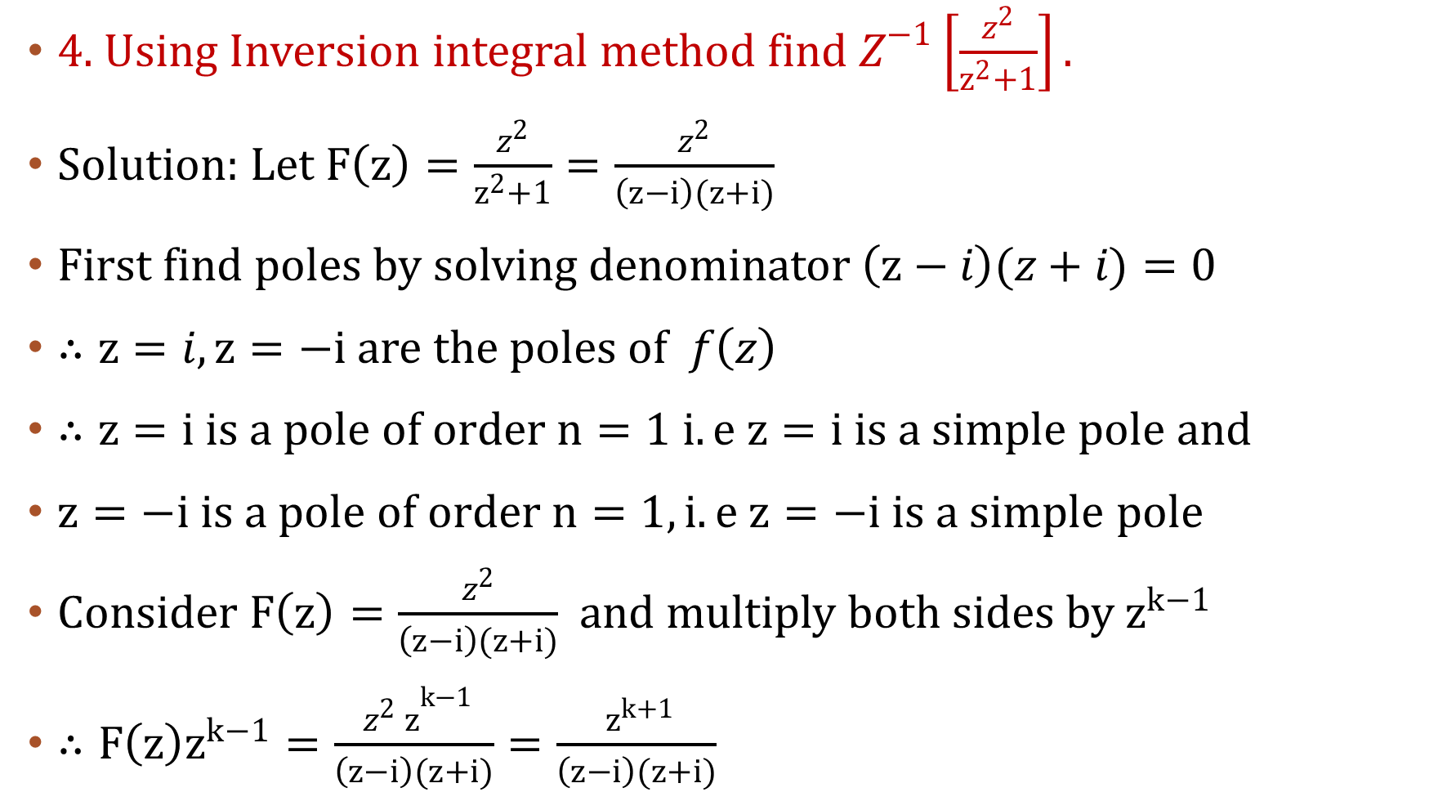
4. Using Inversion integral method find $Z^{−1}\left[\frac{z^{2}}{z^{2}+1}\right].$
Solution: Let $F\left(z\right)=\frac{z^{2}}{z^{2}+1}=\frac{z^{2}}{\left(z−i\right)(z+i)}$
First find poles by solving denominator$\left(z−i\right)(z+i)=0$
$∴z=i, z=−i$ are the poles of $f\left(z\right)$
$∴z=i is a pole of order n=1 i.e z=i is a simple pole$ and
$z=−i is a pole of order n=1, i.e z=−i is a simple pole$
Consider $F\left(z\right)=\frac{z^{2}}{\left(z−i\right)(z+i)}$ and multiply both sides by $z^{k−1}$
$∴F\left(z\right)z^{k−1}=\frac{{ z^{2} z}^{k−1}}{\left(z−i\right)(z+i)}=\frac{{ z}^{k+1}}{\left(z−i\right)(z+i)}$

Slide 17
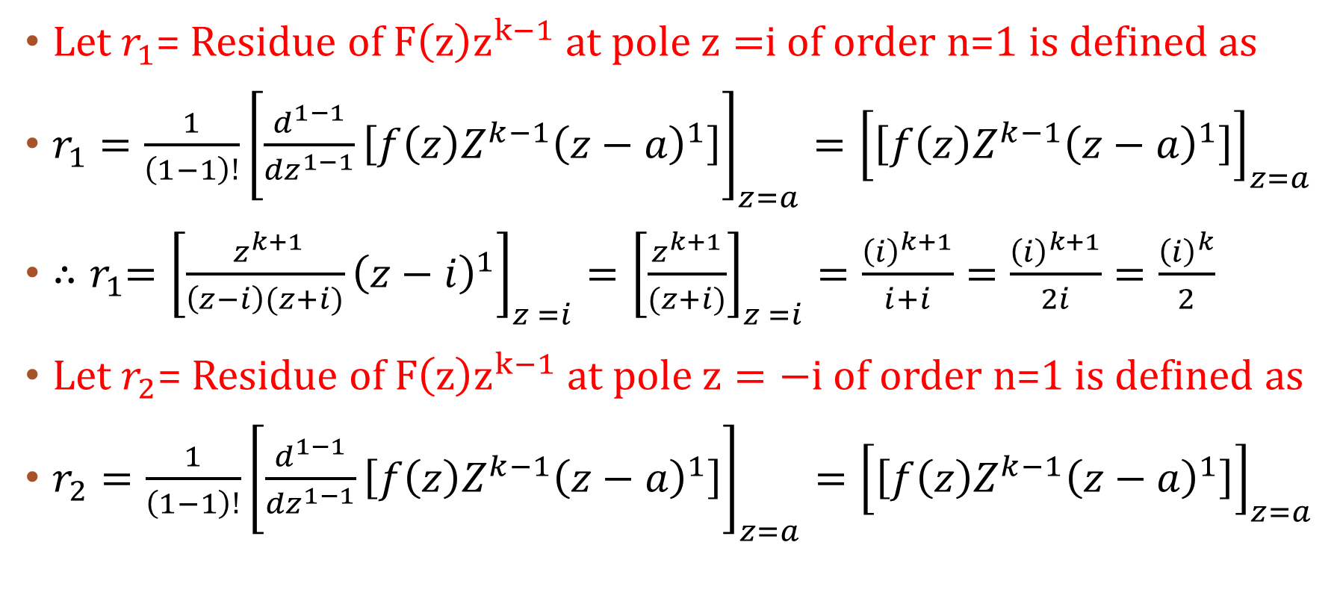
Let $r_{1}$= Residue of $F\left(z\right)z^{k−1}$ at pole $z=$i of order n=1 is defined as
$r_{1}=\frac{1}{\left(1−1\right)!}{\left[\frac{d^{1−1}}{{dz}^{1−1}}\left[{f\left(z\right)Z^{k−1}\left(z−a\right)}^{1}\right]\right]}_{z=a}={\left[\left[{f\left(z\right)Z^{k−1}\left(z−a\right)}^{1}\right]\right]}_{z=a}$
${∴r}_{1}={\left[{\frac{{ z}^{k+1}}{\left(z−i\right)(z+i)}\left(z−i\right)}^{1}\right]}_{z =i}={\left[\frac{z^{k+1}}{(z+i)}\right]}_{z =i}=\frac{{\left(i\right)}^{k+1}}{i+i}=\frac{{\left(i\right)}^{k+1}}{2i}=\frac{{\left(i\right)}^{k}}{2}$
Let $r_{2}$= Residue of $F\left(z\right)z^{k−1}$ at pole $z=−i$ of order n=1 is defined as
$r_{2}=\frac{1}{\left(1−1\right)!}{\left[\frac{d^{1−1}}{{dz}^{1−1}}\left[{f\left(z\right)Z^{k−1}\left(z−a\right)}^{1}\right]\right]}_{z=a}={\left[\left[{f\left(z\right)Z^{k−1}\left(z−a\right)}^{1}\right]\right]}_{z=a}$

Slide 18
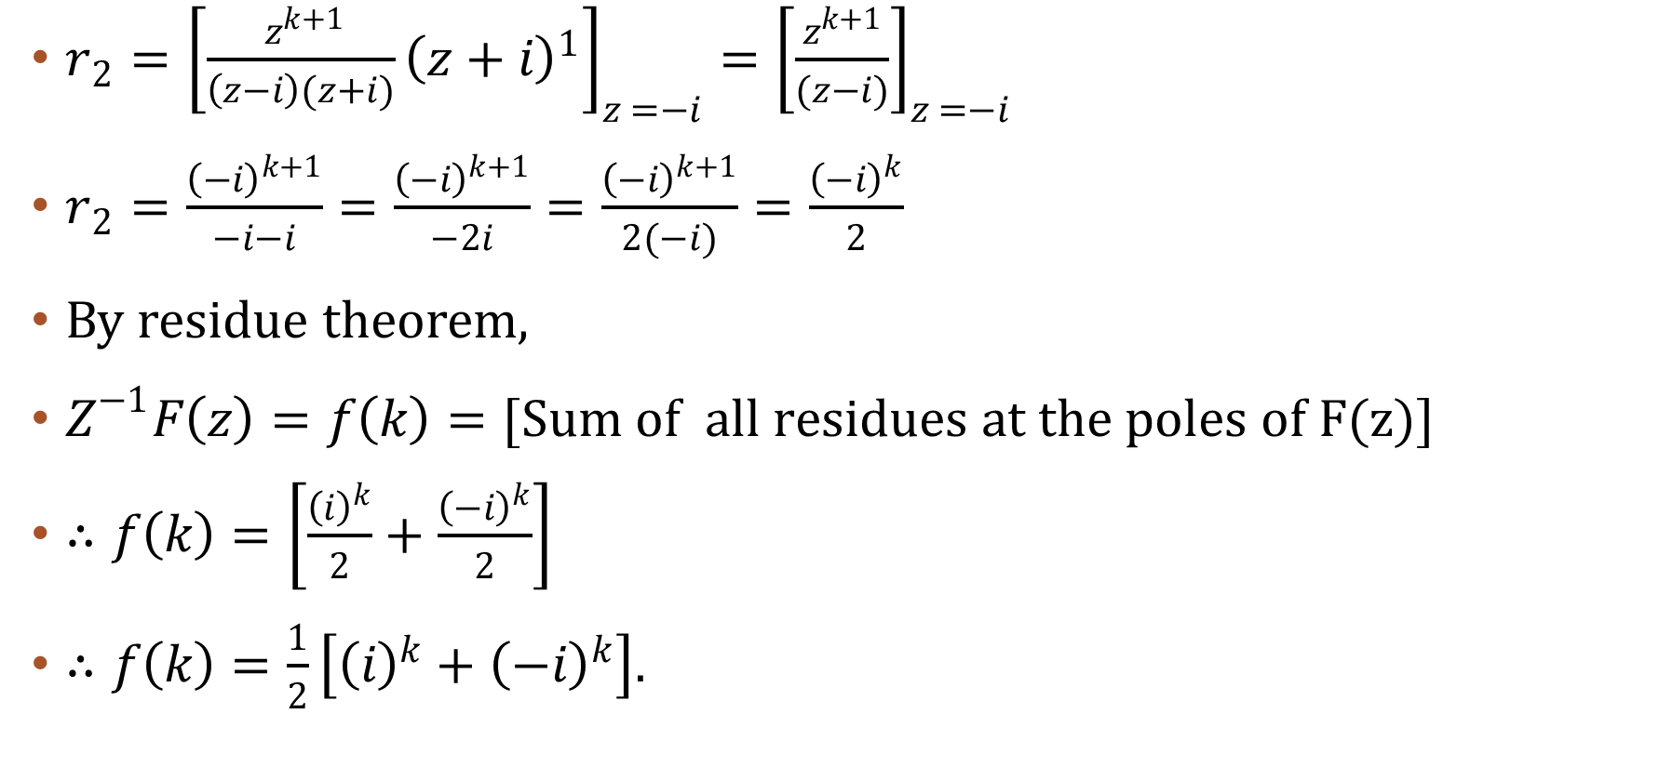
$r_{2}={\left[{\frac{{ z}^{k+1}}{\left(z−i\right)(z+i)}\left(z+i\right)}^{1}\right]}_{z =−i}={\left[\frac{z^{k+1}}{(z−i)}\right]}_{z =−i}$
$r_{2}=\frac{{\left(−i\right)}^{k+1}}{−i−i}=\frac{{\left(−i\right)}^{k+1}}{−2i}=\frac{{\left(−i\right)}^{k+1}}{2(−i)}=\frac{{\left(−i\right)}^{k}}{2}$
By residue theorem,
$Z^{−1}F\left(z\right)=f\left(k\right)=[Sum of all residues at the poles of F(z)]$
$∴f\left(k\right)=\left[\frac{{\left(i\right)}^{k}}{2}+\frac{{\left(−i\right)}^{k}}{2}\right]$
$∴f\left(k\right)=\frac{1}{2}\left[{\left(i\right)}^{k}+{\left(−i\right)}^{k}\right].$

